Slide 1
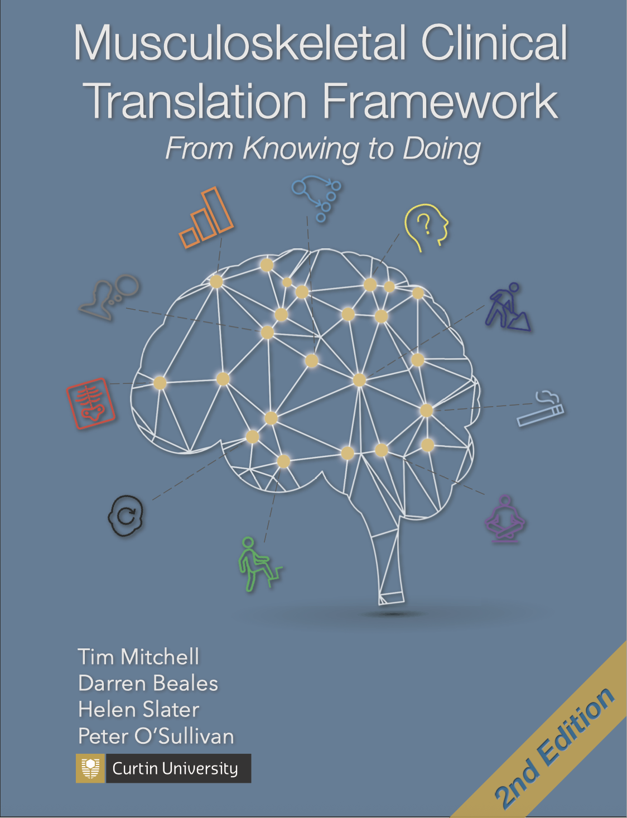
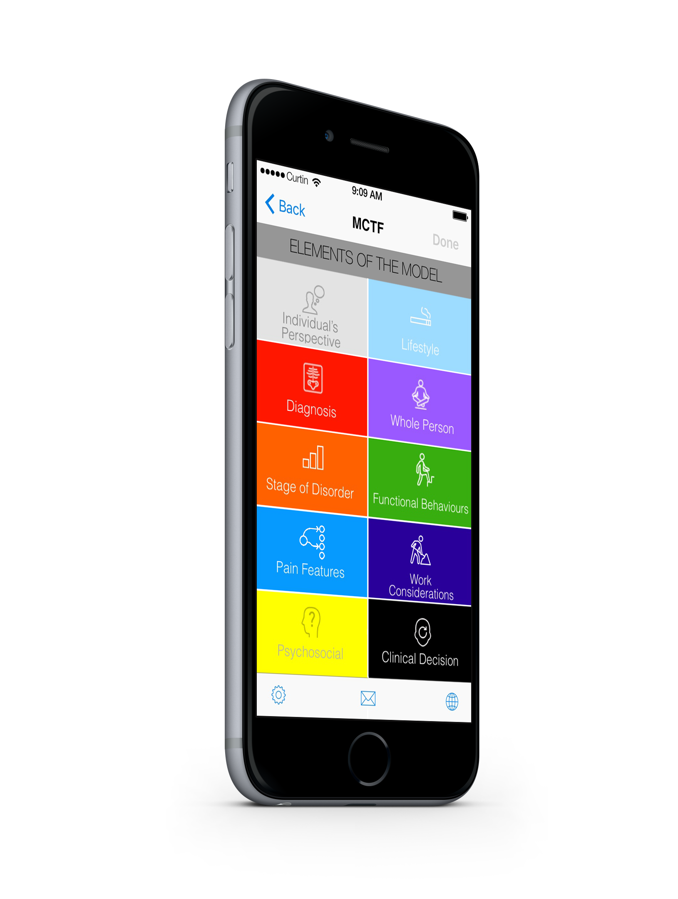

Musculoskeletal Clinical Translation Framework
From knowing to doing
Tim Mitchell
Darren Beales
Helen Slater
Peter O’Sullivan

Slide 2
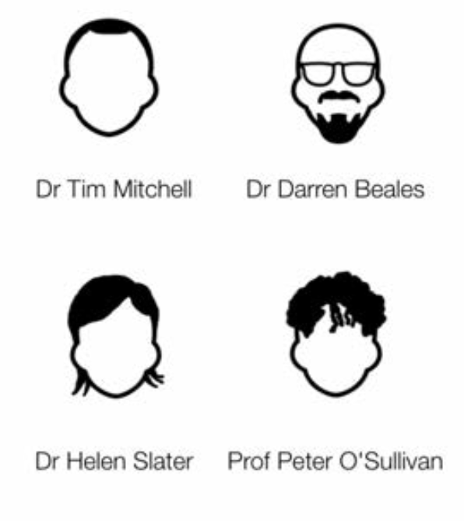

Musculoskeletal Clinical Translation Framework
Dr Tim Mitchell
Dr Darren Beales
Prof Helen Slater
Prof Peter O’Sullivan

Slide 3
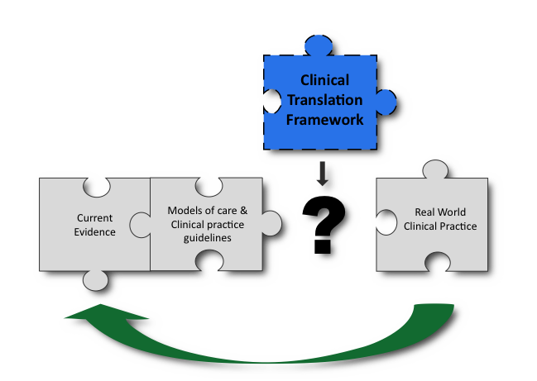
Musculoskeletal Clinical Translation Framework
Mitchell, Beales, Slater & O’Sullivan, 2017

Slide 4
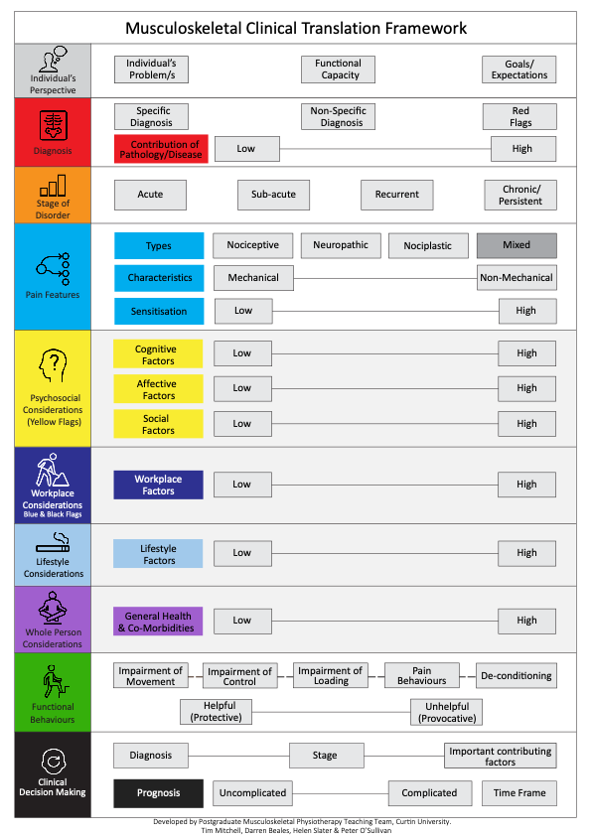
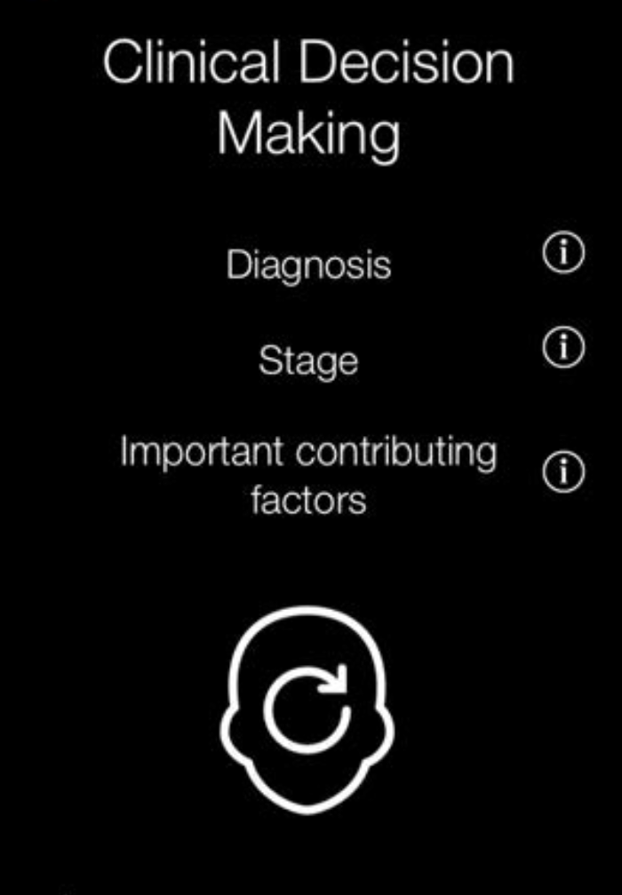

Slide 7
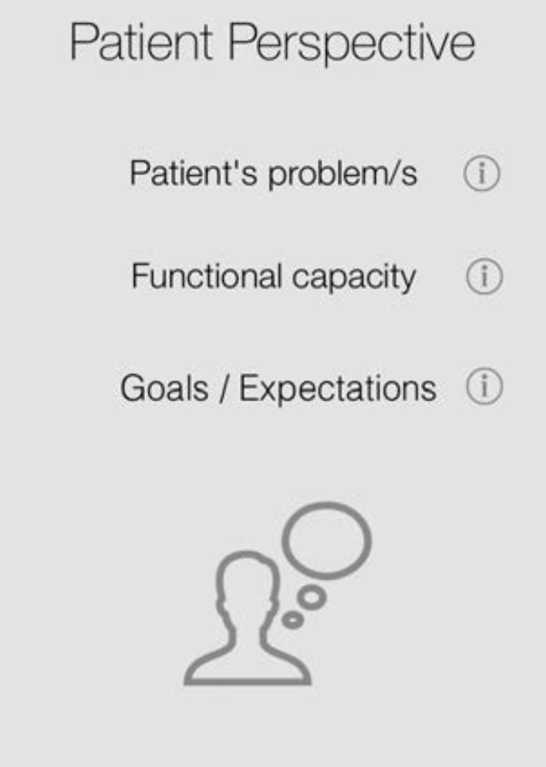
a clinically integrated framework
“Tell me about your problem”
“How do these problems affect you?”
“What can’t you do?”
“What can you do”
“What do you think is wrong?”
“What do you think you need?”
“What do you hope to get out of the session?”

Slide 8
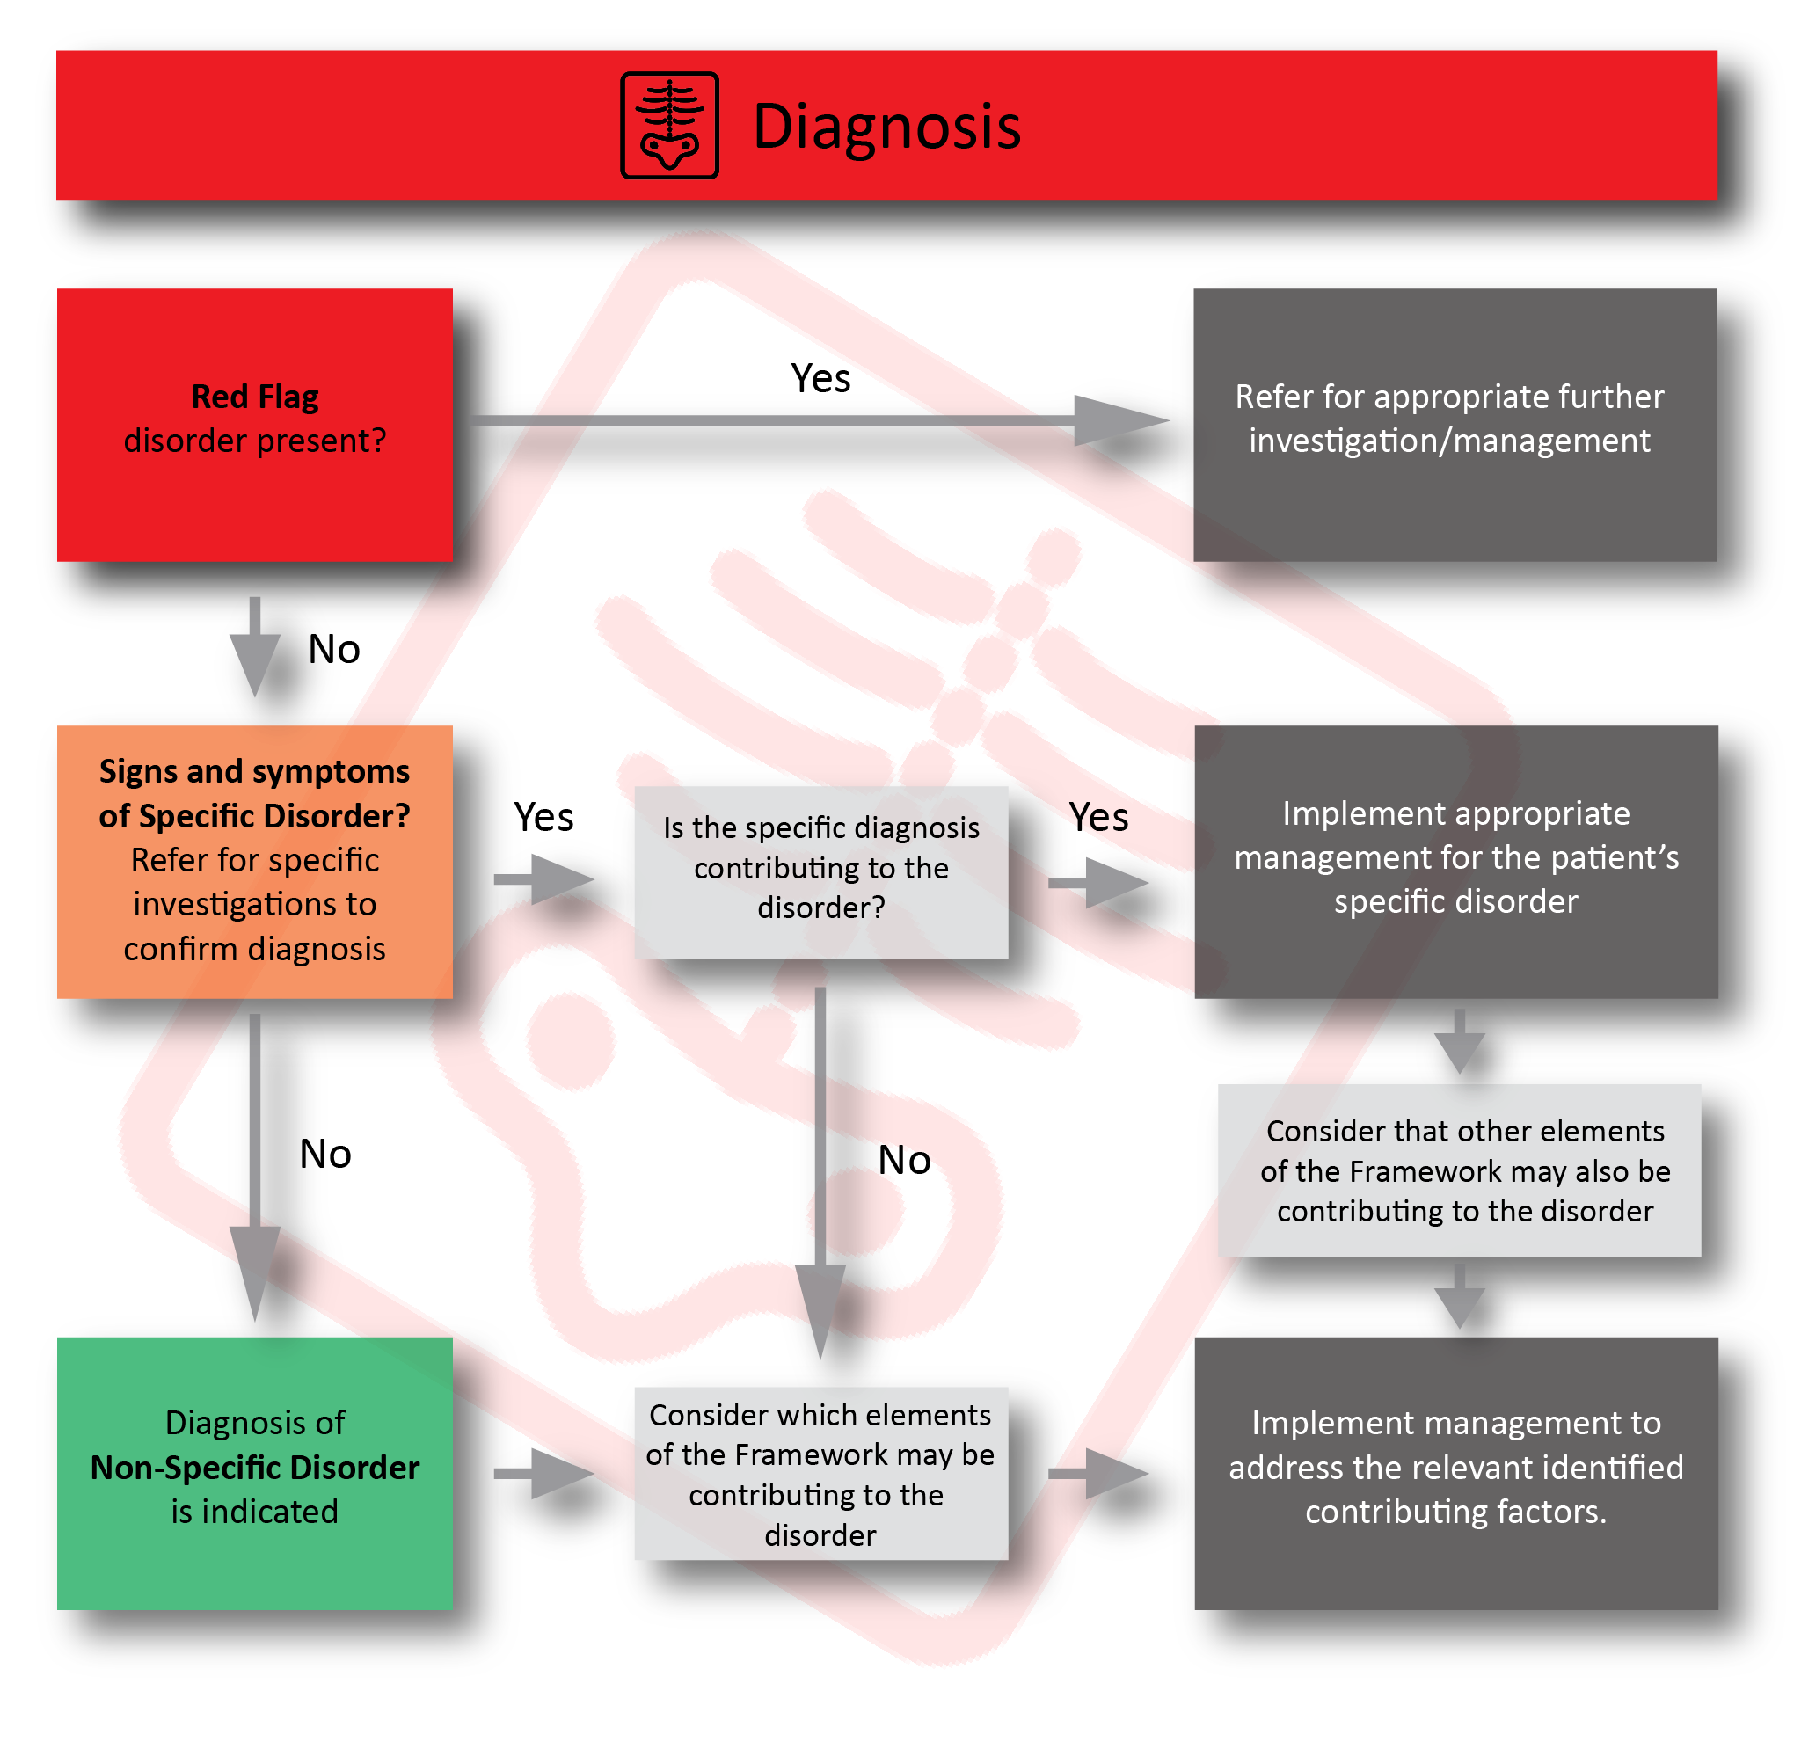

Slide 9
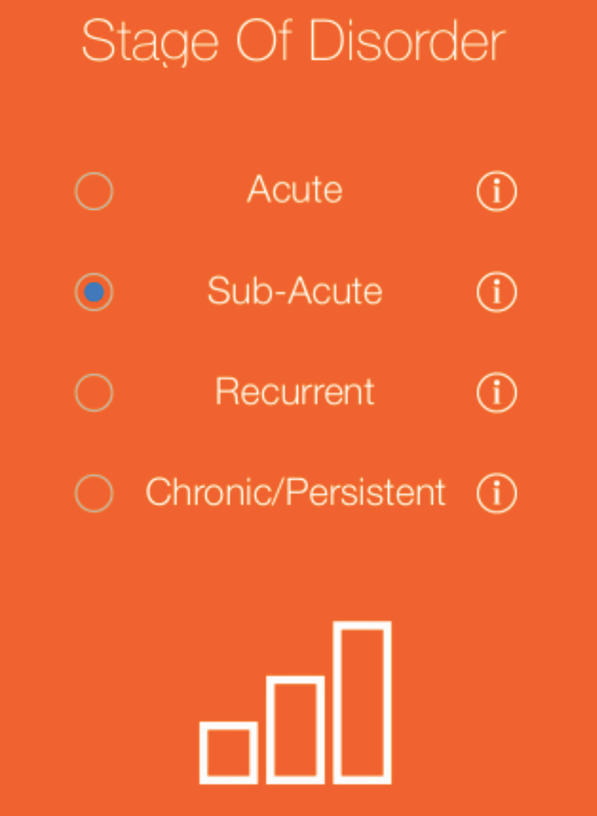
a clinically integrated framework
Not just a linear time progression
Some disorders have no tissue injury
  Eg. Fibromyalgia
  Eg. Non-specific neck pain
Chronic – “pain that extends beyond the expected period of healing” (Turk 2001)

Slide 10
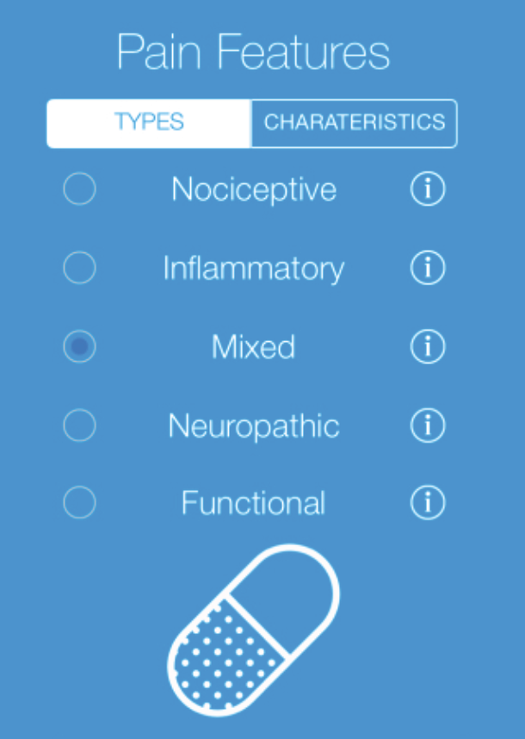
Nociplastic
a clinically integrated framework
Pain Types (Woolf 2010)
Nociceptive - when it is generated by noxious stimuli
Inflammatory - when produced by tissue injury and/or immune cell activation
Neuropathic - when due to a lesion/disease of the nervous system
Nociplastic - Abnormal sensory processing

Slide 11
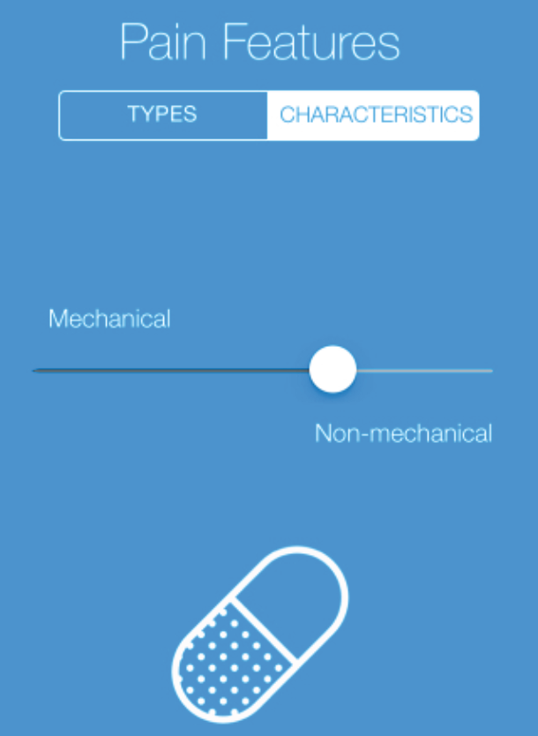
a clinically integrated framework
Mechanical Pain
Pain that is related to or provoked by physical stimulus
Eg. specific movements & postures
Response = Stimulus
Non-Mechanical Pain
Pain that is not specifically related to or provoked by physical stimulus
Includes constant pain, spontaneous pain at rest
Response >> Stimulus

Slide 12
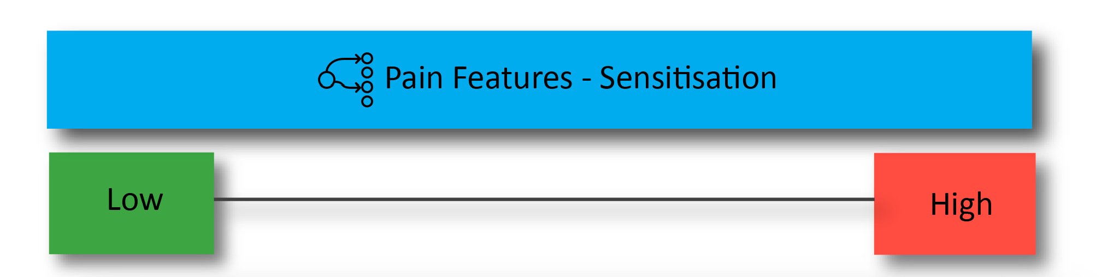
Sensitisation (ease of triggering response) to stimuli such as:
Movement, Posture, Load, Palpation
Sensory (light touch / pressure / thermal)
Stress /distress
Based on the degree of sensitisation:
Is this localised, multisite or widespread?
Is this typical for the clinical history and stage of the disorder? Does it make sense?)
What might be factors contributing to heightened sensitisation?
What are the treatment/management implications (i.e.; clinical pathways)?

Slide 13
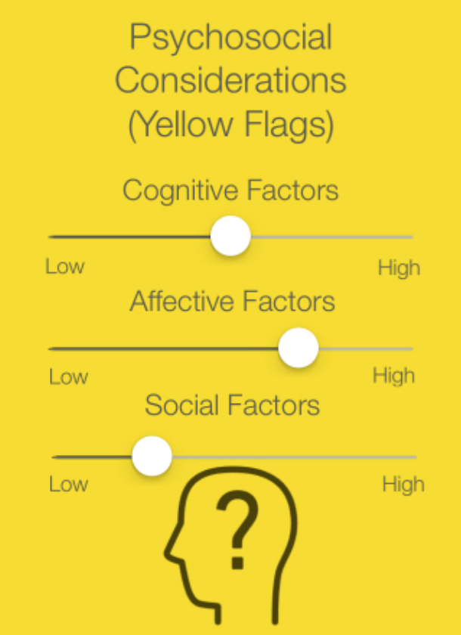
a clinically integrated framework
Cognitive (Thoughts and beliefs)
Attention, attitudes, beliefs, expectations, self- efficacy, catastrophizing, coping
Affective (Emotions)
Depression, anxiety, stress, fear, worry, anger / frustration
Social
Culture, education, relationships, health literacy, socioeconomics

Slide 14
a clinically integrated framework

Slide 15
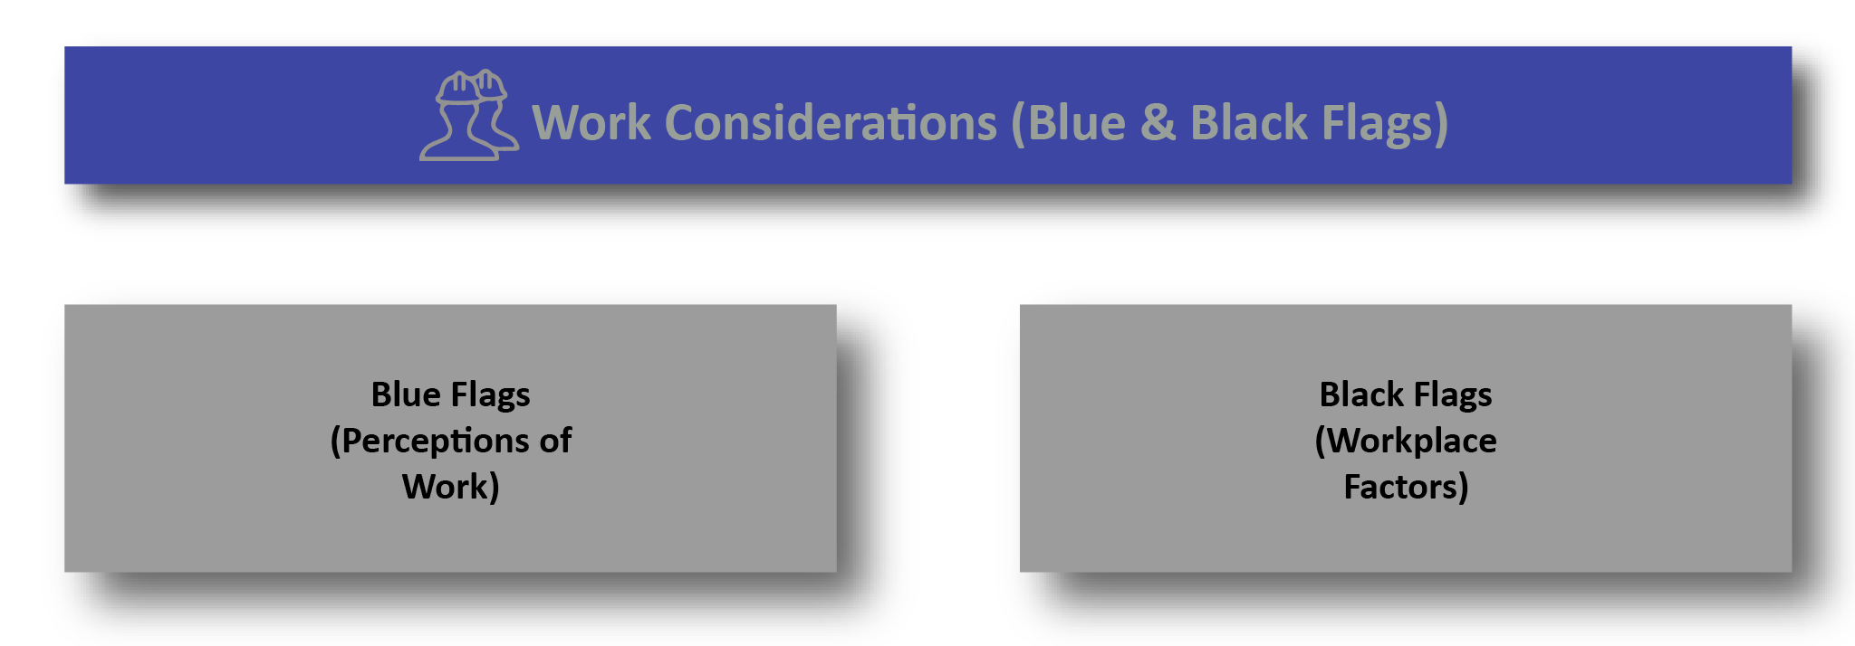
a clinically integrated framework
Job satisfaction
Job culture
Co-worker support
Management
Support
Suitable duties
Nature of work
Job demands
Workplace processes
Compensation claim
Claim acceptance
Legal issues

Slide 16
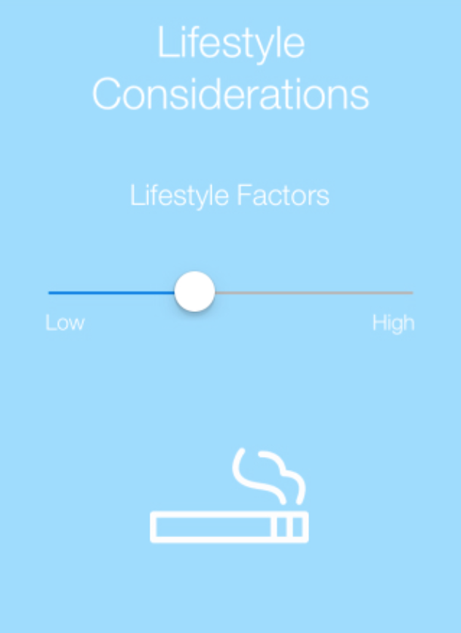
a clinically integrated framework
Physical activity / exercise
Sedentry lifestyle
Sleep
Smoking
Alcohol
Obesity / low BMI
Diet / nutrition

Slide 17
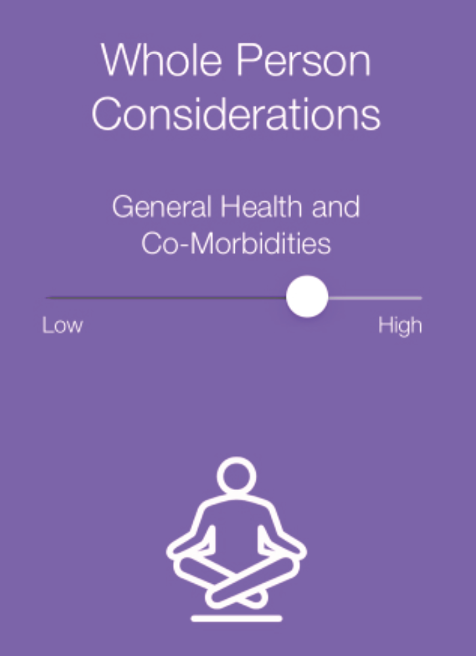
a clinically integrated framework
Presence of co-morbidities
  Eg. Diabetes
  Eg. Metabolic syndrome
Influence of general health factors
  Need for integrated care
  Care in different health settings

Slide 18
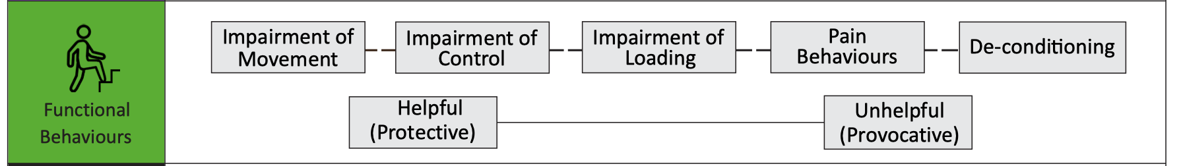
a clinically integrated framework
Helpful
Reflects behaviours that serve to prevent further tissue damage / allow tissue healing to occur
“Normalising” the behaviour results in increased symptom response
Unhelpful
Reflects behaviours that are provocative of a disorder
May reflect the persistence of behaviours in the absence of or past the time of expected tissue healing
“Normalising” the behaviour results in reduced symptom response

Slide 19
a clinically integrated framework
Restricted active and passive movement in the direction of pain provocation.
No impairment of movement in the direction of pain provocation, but where pain is associated with aberrant movement control.
Commonly presents as an intolerance to weightbearing load through painful tissues, that is not due to a primary loss of mobility, muscle weakness of loss of stability. Can affect the limbs or spine.
Overt behavioural responses to pain experience or the anticipation of pain. May include facial grimacing, frowning, breath holding, groaning, demonstrative displays of pain, overt avoidance behaviors.
A deficit in muscle strength, endurance and / or physical capacity.

Slide 20
a clinically integrated framework
Once all elements of the MCTF are considered, an individual profile is established, which includes a Diagnosis, Stage of the Disorder and Contributing Factors weighted according to relative importance.
While this profile will serve to guide and prioritise targeted management, it is important to consider that over time the factors contributing to the individual’s MPD will likely change, necessitating continuous iterative monitoring, evaluation and review.

Slide 21

Prognosis
Providing a prognosis is important to the person with pain
It also helps the clinician to ensure management is on track
Uncomplicated
Suggests recovery will be predictable for their presenting condition
Eg. expect full recovery from an ankle avulsion fracture in 4-8 weeks
Complicated
Suggests recovery will be less predictable than usual for their presenting condition
Eg. expect slower recovery from an ankle avulsion fracture due to contributing factors
OR they have a more complicated condition (eg. CRPS)

Slide 22
Prognosis
Setting a Time-Frame is needed when providing a prognosis
This time frame may not necessarily be for full recovery
  Eg. following ACL reconstruction surgery, an interim goal could be normal walking without discomfort and a time frame for this could be 2-4 weeks.
  Eg with persistent spinal pain, an interim goal could be increasing capacity to spend quality time with family, and a time frame for this could be 6 weeks.
The time frame does not have to be exact or correct
It can be used as an agreed time point to review progress and modify management if needed.

Slide 23
MusculoskeletalFramework.net
Visit website for
Free video & podcast education
Buying the eBook

